Slide 1
The Rule of Charlemagne
General Capitulary for the Missi (802)

Slide 2
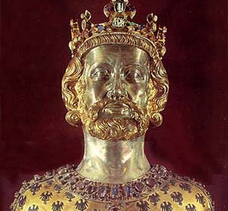
Emperor Charlemagne
(r. 768-814)
Charles “Le Menge” (French for “The Great) rose to power in 768, was considered a great king, who was akin to the Old Testament king David.
Today scholars see him as a complex, contradictory and sometimes brutal king.

Slide 3
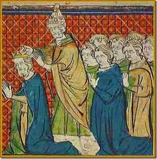
Christmas Day 800 A.D.
Charlemagne is declared “Augustus” (emperor) the Imperial title of the first Roman Emperor by Pope Leo III.
This was done by the pope in hopes to exalt the king of the Franks and downgrade the Byzantium ruler

Slide 4
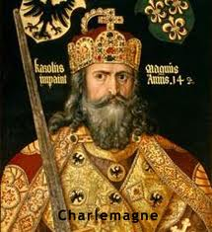


Slide 5
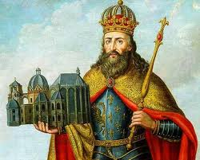

Slide 6
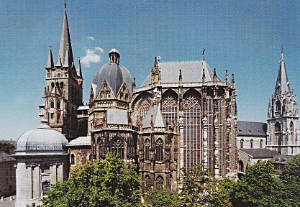

Slide 7
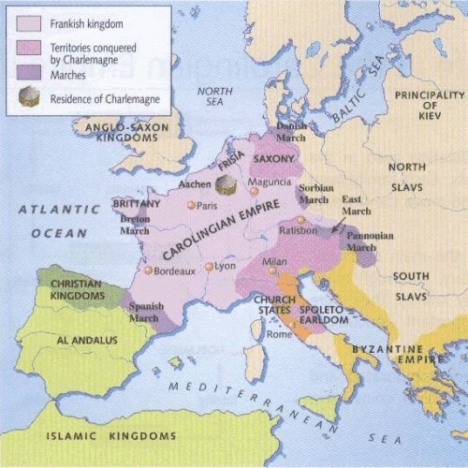
Carolingian Empire
Under the rule of Charlemagne the Empire grew to include present day Spain, Italy, Austria, and Germany

Slide 8
The Plan:
Charlemagne dreamed of an empire that would unite military and intellectual traditions of the Roman and Germanic worlds with the legacy of Christianity
Built an empire “unheard of since the time of the Roman Empire”
Wanted to model his empire after that of the Roman Empire
Charlemagne centralized his government by dispatching officials (missi) annually to every part of his empire to review the local affairs and enforce royal legislation
Sponsored building programs
Became patron of intellectual and artistic efforts
Supported scholarship and education

Slide 9
By force if necessary…..
While expanding his empire, like the Romans, he encountered resistance.
Invaded Italy in 774 taking the crown from the Lombard kings, annexing northern Italy into his empire.
Moved northward, fighting a 30+ year war with the Saxons.
Forcibly annexed Saxon territory, converting the Saxon people to Christianity “by point of sword” through “mass baptisms”

Slide 10
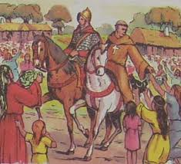
Missi Dominici
“those sent out by the lord king”
Special officials of lay aristocrats or bishops sent by Charlemagne to discourage corruption within the Empire.
Traveling in pairs, these men met annually with the regional governors
The missi used a capitulary- a document stating the basic guidelines for the annual visits

Slide 11
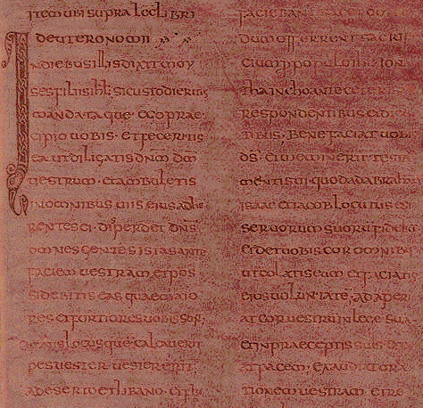

Slide 12
Missi Dominici: Job Description
The missi were the “wisest and most prudent men” chosen (by Charlemagne) from the nobles, clergy and pious laymen.
“And let the missi themselves make a diligent investigation whenever any man claims that an injustice has been done to him by any one, just as they desire to deserve the grace of omnipotent God and to keep their fidelity promised to Him, so that entirely in all cases everywhere, in accordance with the fear and will of God, they shall administer the law fully and justly in the case of the holy churches of God and of the poor, of wards and widows and of the whole people.

Slide 13
Capitulary: Laws on the go
The missi, responsible for enforcing laws used a capitulary-the document providing basic guidelines for the annual visits

Slide 14
Word of Law
No one must attempt to thwart the law of the emperor.
Fidelity to the lord emperor. “Every man in his whole kingdom, whether ecclesiastic or layman…..should now promise to him as emperor the fidelity which he previously promised him as king.
All must strive to live “wholly in the holy service of God in accordance with the precept of God and in accordance with his own promise, because the lord emperor is unable to give all individually the necessary care and discipline.
Fraud, perjury, bribery and theft are not tolerated.
Fugitive fiscaline slaves are not to be harbored
Military service is required:”No one shall neglect a summons to war from the lord emperor” and cannot dismiss any military service owed “on account of relationship or flattery or gifts from any one”
Emperor's word is law:
No one must neglect (or attempt to get out of) paying taxes.
Justice for all (except slaves…)
All decrees will be known throughout the empire

Slide 15
Trivia
Charlemagne supported intellectual pursuit and scholarly enterprise, but never learned to write
Standardized weights and measures system
Was crowned Emperor on Christmas day
Missi Dominici means “those sent out by the lord king”
Charlemagne is thought to have inspired the later “Holy Roman Empire”

