Slide 1
Melinda Fidler
Music 1010 class

Slide 2
Piano Concerto in E minor Op. 85
Composed by Edward Elgar

Slide 3
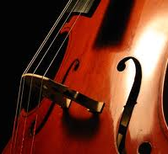
Absolute Music with inspiration.
The Cello Concerto in E minor Op. 85 is a wonderfully majestic and yet mournful piece that laments of a lost time and lost ideals. Written by Edward Elgar after World War I, this is a thoughtful and tragic piece of music that was inspired by the Great War.

Slide 4
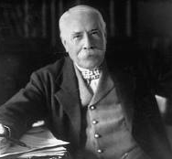
Edward Elgar
After World War I, Elgar wanted to compose a piece of music that would contain the feelings and emotions of the turmoil and sadness that was the War.

Slide 5
Edward Elgar: A Biography
Edward Elgar was born in the village of Broadheath in Worcester, England. His father, a musician, owned a music shop and tuned pianos. Growing up surrounded by music had its advantages, and Edward, already showing signs at an early age of musical adeptness, mastered several instruments as well as composition. He continued his studies after finishing school, and went on to write several successful pieces of music. He performed with a variety of local groups while earning his living by teaching the organ and violin at St. George’s, a Roman Catholic Church located in Worcester. In the year 1889 he married Caroline Alice Roberts, one of his students, and daughter to Major-General Roberts. Though her aunts and cousins thought it was beneath her to marry a “tradesman”, she would not be dissuaded from her choice, becoming, in married life, a driving force of faith and determination and helped greatly with the development of her husband’s career. From 1890 to 1900 his works began to gain popularity beyond his native village, having such works as Froissart and The Black Knight become popular with the great choral societies of the Midlands and Northern England. In 1899 his work Variations on and Original Theme (Enigma) became a great success in London, and through its masterful composition, technical achievement, and forceful musical personality, it proved Elgar had surpassed other leading composers of the time. From 1901 to 1914, Edward Elgar was considered to be the “composer of the day”. In July of 1904, Edward was knighted by King Edward VII. It was also during this time period that he wrote several masterpieces, among these, the overture Cockaigne, the Introduction and Allegro for the Strings, the choral works The Apostles and The Kingdom, Falstaff, and Pomp and Circumstance March No. 1; his most popular work of the time as well as being one of his most recognized works of today. It was during The Great War (WW1) a disheartened Elgar took a break from much of his writings, and aside from a few patriotic pieces, including the settings for three war poems by Laurence Binyon called The Spirit of England, the incidental piece for the children’s play The Starlight Express, and the ballet The Sanguine Fan, he did not produce anything major until the war’s end in 1918. It was during the years 1918 and 1919 that he entered his final great period, producing three chamber works—the Piano Quintet in A minor, the Violin Sonata, the String Quartet (both of these last pieces being in E minor) and his final masterpiece the Cello Concerto in E minor. In 1920, his wife Alice passed away and it was said much of his inspiration died with her, for he did not compose anything that was not from earlier sketches until a year before his death. In 1933 he began a number of new projects, including the opera The Spanish Lady, and a third symphony. Later that same year he was diagnosed with a malignant tumor, one that pressed upon his sciatic nerve, and he died in February of 1934 in his native Worcester.
Edward Elgar Biography http://www.naxos.com/person/Edward_Elgar_26026/26026.htm

Slide 6
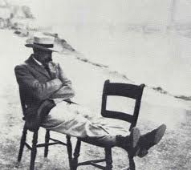
Edward Elgar
(1857-1934)

Slide 7
Concerto: History Behind the Piece
After the chaos, destruction and tragedy of The Great War (World War 1) Edward Elgar became disillusioned with the suffering that had been caused by it; at the same time he realized that the world would never be the same as it once had been. He became withdrawn from musical composition and only wrote a few pieces during the whole of the war. It was in 1918, at the War’s end, that he began to compose major works again. According to one source, the melody that would become the first part of the concerto came about after Edward had surgery in which an infected tonsil was removed, when awaking from the anesthesia he asked for pencil and paper, and thus the melody was born. It really began to take its true form in 1919 while Elgar and his wife were staying at the family’s secluded cottage “Brinkwells” located near the village of Fittleworth in Sussex, England. During the years of the war, the place, located near the Channel, Elgar had heard the distant rumble of the artillery fire from France. Here in 1919, while both Elgar and his wife were recovering from health problems, the Cello concerto moved from the idea stages to becoming a full work. It would have four movements unlike its counterparts which only had 3, and would be as concise at it was expansive. It was an emotional outpouring of remorse and nostalgia for a lost world. A lament of a better time, and a piece which his wife noted was unlike any of his prior works. He dedicated the piece to his friends, Sir Sydney and Lady Frances Colvin. On the night of the concerto’s premiere it suffered a near disaster when the conductor of the London Symphony Orchestra Albert Coates, a man well known for his liberal use of rehearsal time (including that of other performers) took over an hour of the rehearsal time for the Concerto piece Elgar would himself be conducting. As a result, the under-rehearsed performance had terrible reviews, and caused an uncharacteristic explosion of anger from Elgar. Had it not been for the diligent preparation work of the piece by Felix Salmond, Elgar would have pulled it from the concert entirely.
http://www.classiccat.net/elgar_e/85.info.php
http://www.classiccat.net/elgar_e/85.info.php

Slide 8
The Great War
The “War to end all Wars” became known later in history as World War I. It also became the mournful inspiration for Edward Elgar as he lived through the time and witnessed the tragedy.

Slide 9
World War I Trivia:
Tsar Nicholas II of Russia, King George V of England and Kaiser Wilhelm II of Germany were cousins.
The War was not only fought with guns, it was fought with Propaganda.
World War I was called the “War to end all Wars” and the “Great War”.
The Christmas ceasefire of 1914 became a legendary act of breaking the Propaganda war and showed that even in warfare, a little peace on earth can happen.

Slide 10
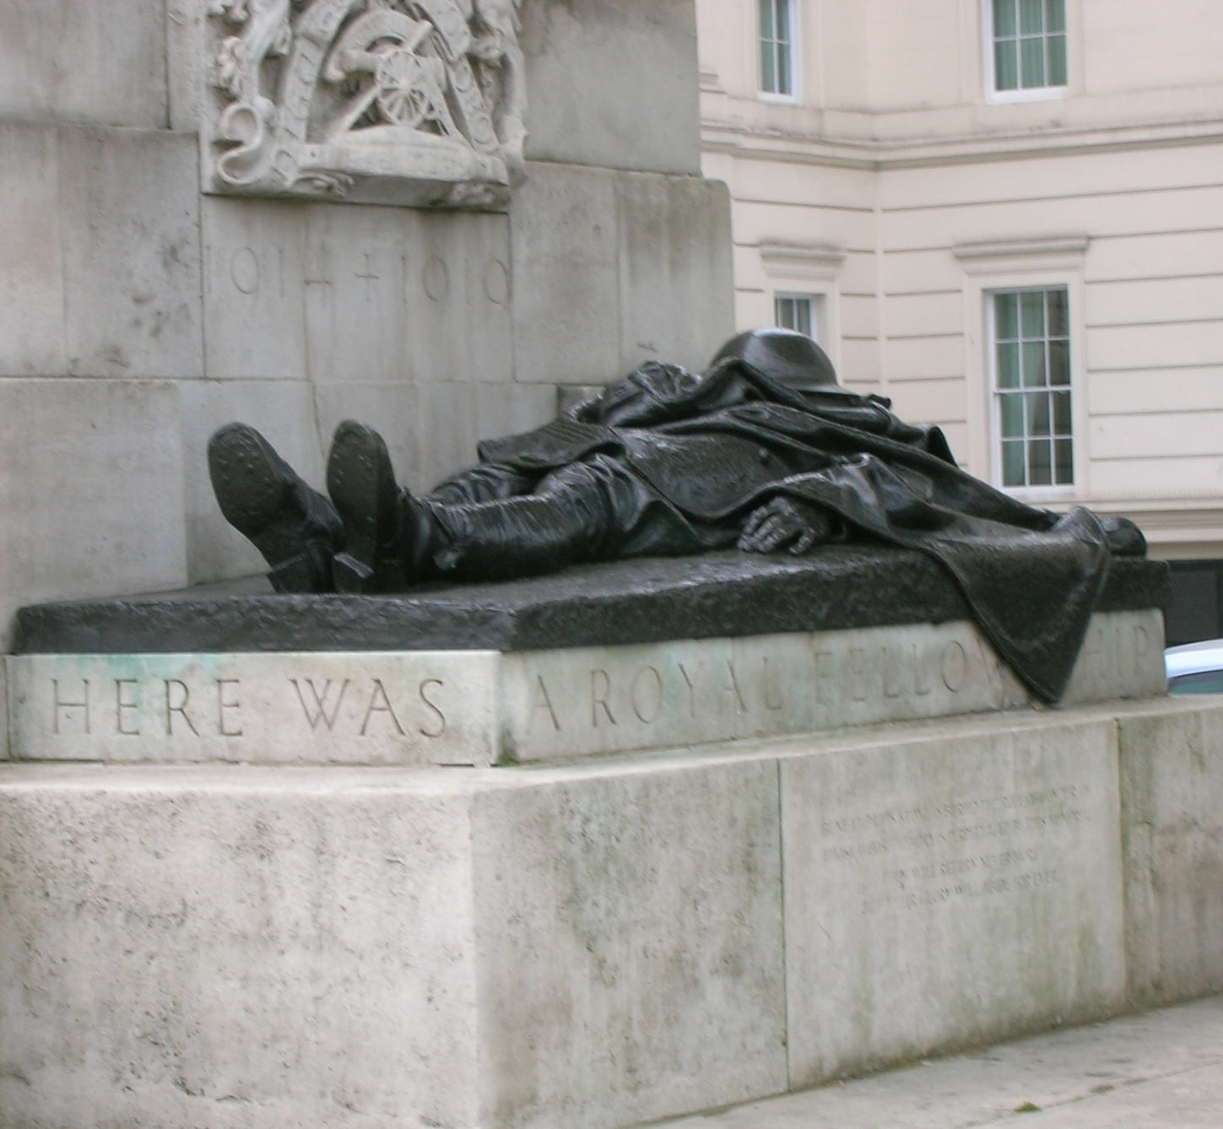
Casualties of War
This Memorial in Hyde Park, London, U.K. is dedicated to the casualties of the Royal Regiment of Artillery in WWI. The Fallen Soldier is only a small part of the larger monument. The engraving under the soldier reads: “Here was a Royal Fellowship of Death”.

Slide 11
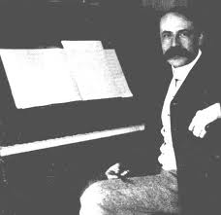
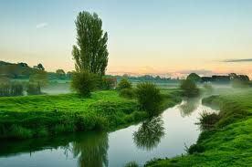
Gaining Inspiration:
Composer Edward Elgar prior to WWI
Fittleworth, Sussex, U.K.

Slide 12
A Masterpiece is born
The Cello Concerto was the first major work Edward Elgar had produced since 1914.
Elgar composed the piece at his summer cottage “Brinkwells” in Sussex, where, during the war, he could hear the distant artillery fire from across the channel.
Upon hearing the piece, Elgar’s wife Alice described it as being “unlike anything” her husband had written before.

Slide 13
It Almost wasn’t….
On the night of the concerto’s premiere it suffered a near disaster when the conductor of the London Symphony Orchestra Albert Coates, a man well known for his liberal use of rehearsal time (including that of other performers) took over an hour of the rehearsal time for the Concerto piece Elgar would himself be conducting. As a result, the under-rehearsed performance had terrible reviews, and caused an uncharacteristic explosion of anger from Elgar. Had it not been for the diligent preparation work of the piece by Felix Salmond, Elgar would have pulled it from the concert entirely. http://www.classiccat.net/elgar_e/85.info.php

Slide 14
Listening Guide:
http://www.rhapsody.com/share/Tra.2698410

Slide 15
A Guide to the music:
Instruments piece was scored for: Cello, 2 Flutes/piccolo, 2 Oboes, 2 Clarinets in A, 2 Bassoons, 4 Horns in F, 2 Trumpets in C, 3 Trombones, Tuba, Timpani, strings, and percussion. Piece performed by Maria Kliegel.

Slide 16
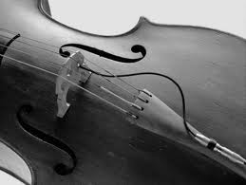
Listen to the music…..
0:00 the piece begins with a recitative Cello solo in minor, a quick and abrupt declamation, bringing a melodramatic tone to the melody.
0:13 the strings play softly in the background, adding texture and harmony to the cello solo. This played so quickly and softly that one nearly misses it entirely.

Slide 17
0:19 the strings repeat the variation quickly in a seemingly sorrowful undertone.
0:29 the cello tone ascends for a moment before descending significantly, just before strings join in.
0:32 the strings join in major
0:35 the clarinets and horns play the same sequence that the strings and cello play.
0:45 the strings play a soft ending for the clarinet and horn piece.
0:52 the cello recitative begins again, playing in an ascending major, building to the climax.
1:12 the strings play a repetition of the earlier, softer piece, it is a contemplative.

Slide 18
1:23 the cello can be heard joining into the melody being played and follows the lilting melody of the strings until it again comes to the foreground.
1:37 the cello recitative plays again, with the horns and flutes playing a soft notation.
2:00 the string variation plays again.
2:06 the string variation continues, repeating the harmony of the cello as it once again begins playing.
2:13 the melody has a quick lilting presence before it begins ascending again in a nostalgic tone.
2:16 the bass joins in a minor variation, adding an ominous presence to the piece.
2:23 the ominous bass continues its descent while the cello ascends.

Slide 19
2:25 the strings join in again, continuing he variation of the bass.
2:38The piece begins to build higher, heading for a culmination of the emotion.
2:48 the music peaks as it becomes louder and the full orchestra can be heard.
3:05 the bass again comes in a louder pitch, another version of the ominous variation played before.
3:14 the cello recitative comes in again.
3:48 the horns appear again in repetition of the melody.
3:53 the cello and strings begin to sound more wistful.
4:04 the melody continues to build again as the full orchestra variations are heard.

Slide 20
4:30 the cello begins a major tone.
5:07 the strings make a sharp statement creating tension to the happier notes
5:16 the cello continues in a major building upon the repetition of the melody
5:45 the melody repeats
6:01 the melody of the cello arches while the strings follow shortly after
6:15 the piece plays softer as the tone becomes thoughtful.
6:25 the flutes and clarinets play the lilting variation in a pensively playful moment.
6:29 the cello follows suit playing the same variation the flutes have in a more dramatic fashion.

Slide 21
6:35 the cello plays again the lilting melody with a deeper emotion as the strings play the ominous undertone.
6:58 the flutes play a new quick ascending variation while the cello continues its recitative.
7:02 the strings and horns join in the new variation before ending in a high pitch.
7:10 the cello begins a descending tone once again, in a very mournful fashion.
7:14 the strings begin their original sad melody.
7:27 the cello begins ascending again building for a finale.
7:42 the full orchestra repeats the dramatic melody played in the middle at 5:07
8:14 the percussion is heard for the first time in a short melody that is reminiscent of a march with two simple beats

Slide 22
8:15-8:47 the cello descends into a more sorrowful lilt and the orchestration begins to play softer, as the cello strings are plucked quickly as the melody becomes again more thoughtful and nostalgic.
8:50 the full orchestra ascends in quick fashion in a dramatic finale leaving the piece with a very dramatic end, and, in my opinion, it is as though there were the words “and then suddenly” leaving the sentence unfinished, much as many of the lives that were lost in the war were.

Slide 23
Works Cited
British Paintings (Edward Elgar). September 24, 2009. http://goldenagepaintings.blogspot.com/2009/09/edward-elgar.html (accessed November 13, 2011).
Cello Concerto in E Minor. http://imslp.org/wiki/Cello_Concerto,_Op.85_(Elgar,_Edward) (accessed September 20, 2011).
Cello Concerto in E Minor--Edward Elgar. http://www.classiccat.net/elgar_e/85.info.php (accessed September 21, 2011).
Edward Elgar. http://www.naxos.com/person/Edward_Elgar_26026/26026.htm (accessed September 21, 2011).
Edward Elgar Biography. http://www.elgar.org/2english.htm (accessed September 20, 2011).
Edward Elgar Biography. http://www.8notes.com/biographies/elgar.asp (accessed September 21, 2011).
Edward Elgar in 1901. http://www.philharmonia.co.uk/concerts/series/elgar/ (accessed November 13, 2011).
Fidler, Melinda. "Here Lies a Royal Fellow." London, June 11, 2009.
MacDonald, Hugh. Edward Elgar Cello Concerto in E minor, Opus 85. http://www.bso.org/images/program_notes/elgar_celloconcerto.pdf (accessed September 21, 2011).
Nelson, David. Elgar's Enigma Variations. September 24, 2011. http://inmozartsfootsteps.com/1298/elgars-enigma-variations/ (accessed November 13, 2011).
Pixdaus. http://pixdaus.com/single.php?id=196115 (accessed November 13, 2011).
Sir Edward Elgar. http://www.steenslid.com/music/elgar/ (accessed November 13, 2011).

